Slide 1
An effective sentence-extraction technique using contextual information and statistical approaches for text summarization
Youngjoong Ko (a,*) , Jungyun Seo (b)
a. Department of Computer Engineering, Dong-A University (Republic of Korea)
b. Department of Computer Science and Interdisciplinary Program of Integrated Biotechnology, Sogang University (Republic of Korea)
Pattern Recognition Letters, 2008

Slide 2
Introduction (1/4)
Text summarization sets the goal at extracting information content, and presenting the most important content to a user.
To achieve this goal, text summarization systems should identify the most salient information in a document
Traditional text summarization systems have used linguistic approaches and statistical approaches to extract salient sentences.
But there are some problems in using both methods

Slide 3
Introduction (2/4)
Linguistic approaches would be very useful resources to understand a document for summary-generation, but they require much memory and processor capacity because of additional linguistic knowledge and complex linguistic processing.
Linguistic Tool: a discourse parser, etc.
Linguistic resources: WordNet, Lexical Chain, etc. (Barzilay and Elhadad, 1999; Miller et al., 1990; Ko et al., 2003)

Slide 4
Introduction (3/4)
Statistical approaches can summarize texts using various statistical features (title, location, etc.).
They do not suffer from a memory and processor capacity problem. But all the statistical features are not effective for summarization in every case.
Some features depend on the particular format and the writing style of documents such as title and location.
Title cannot be effective feature if a document does not include any title information

Slide 5
Introduction (4/4)
This paper presents the TF-based query method, which is used in a no-title style document, and it attempts to combine statistical approaches by using contextual information for text summarization.
The proposed method would use bi-gram to solve the Feature Sparseness Problem. (Feature Sparseness Problem: extracting features from only one sentence for sentence-extraction.)
The proposed method would use hybrid statistical approach to show better performance in summarization.

Slide 6
General Statistical Methods

Slide 7
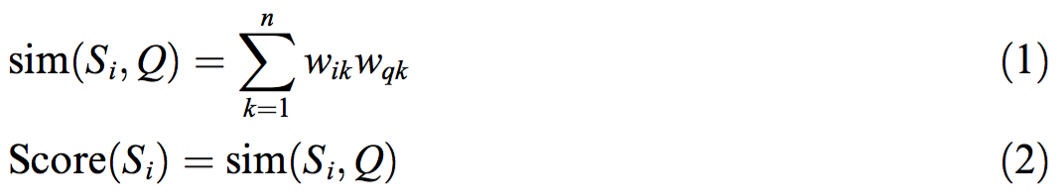
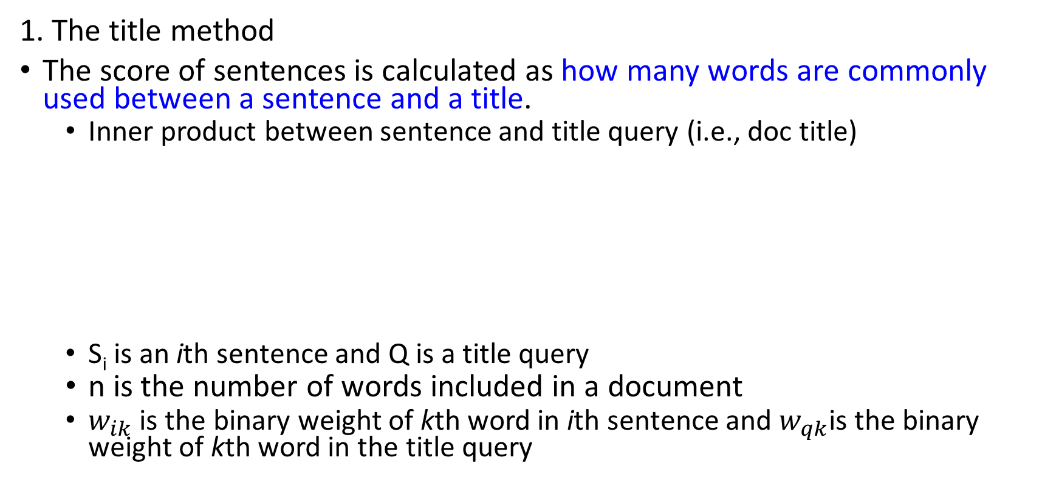
General Statistical Methods (1/5)
1. The title method
The score of sentences is calculated as how many words are commonly used between a sentence and a title.
Inner product between sentence and title query (i.e., doc title)
S_{i} is an ith sentence and Q is a title query
n is the number of words included in a document
$w_{ik}$ is the binary weight of kth word in ith sentence and $w_{qk}$is the binary weight of kth word in the title query
Notes:
和標題越像的句子分數越高

Slide 8
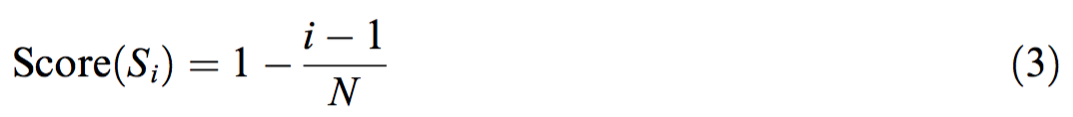
General Statistical Methods (2/5)
2. The location method
It has been said that the leading several sentences of an article are important and a good summary (Wasson, 1998).
S_{i} is a ith sentence
N is the total number of sentences in the document
the leading sentences get higher score
Notes:
越前面的句子分數越高

Slide 9
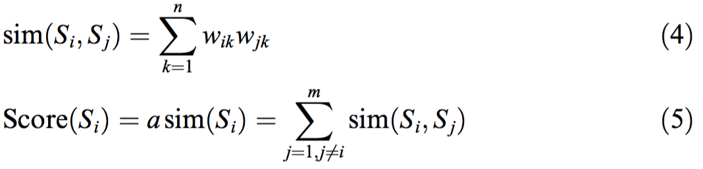
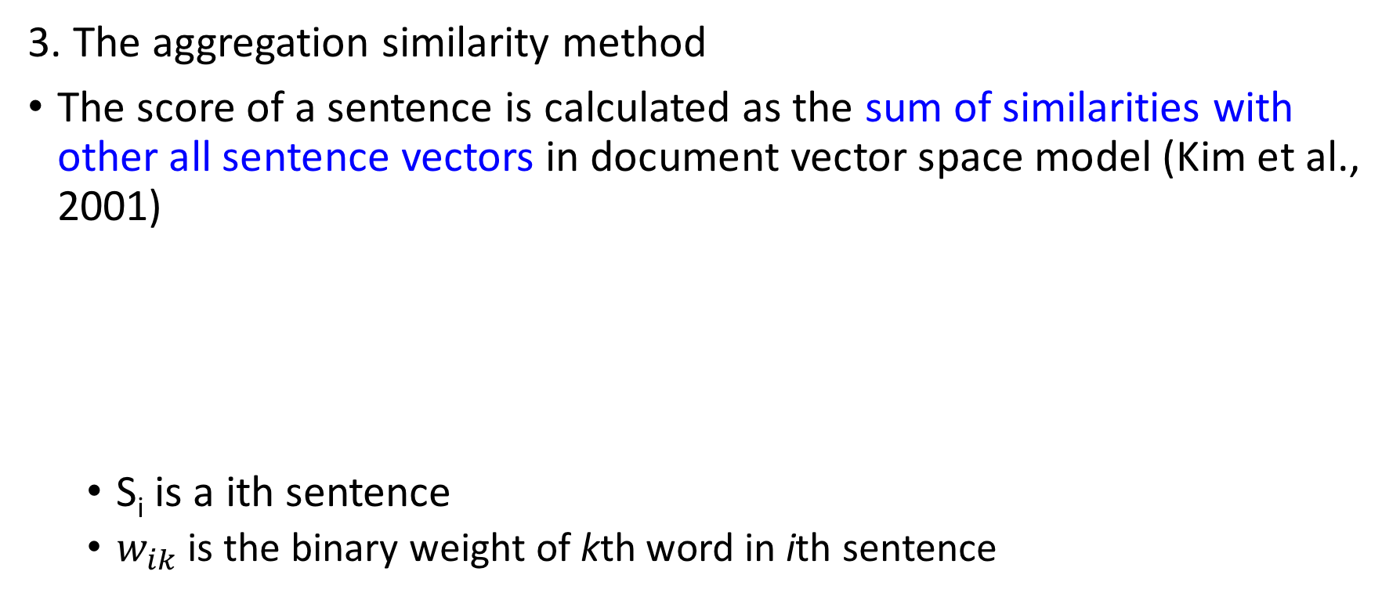
General Statistical Methods (3/5)
3. The aggregation similarity method
The score of a sentence is calculated as the sum of similarities with other all sentence vectors in document vector space model (Kim et al., 2001)
S_{i} is a ith sentence
$w_{ik}$ is the binary weight of kth word in ith sentence
Notes:
每個句子的分數都是由此句子和其他句子的相似度總和決定

Slide 10
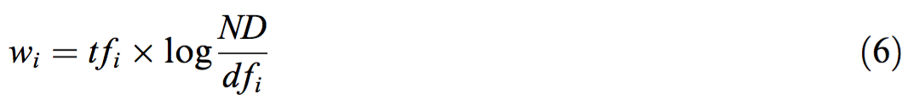
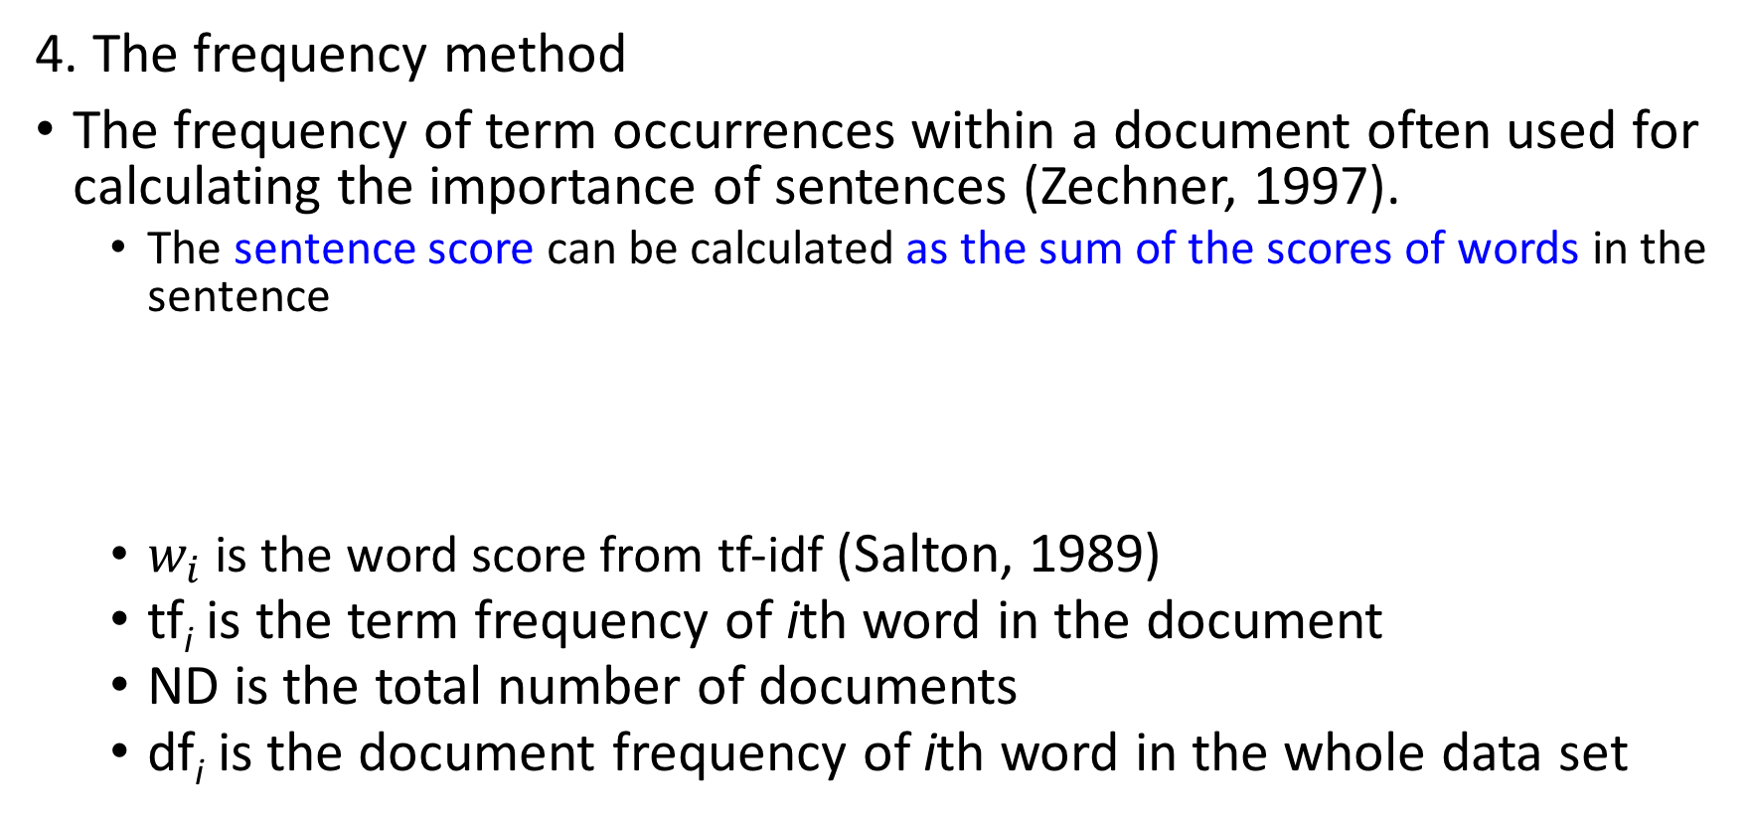
General Statistical Methods (4/5)
4. The frequency method
The frequency of term occurrences within a document often used for calculating the importance of sentences (Zechner, 1997).
The sentence score can be calculated as the sum of the scores of words in the sentence
$w_{i}$ is the word score from tf-idf (Salton, 1989)
tf_{i} is the term frequency of ith word in the document
ND is the total number of documents
df_{i} is the document frequency of ith word in the whole data set
Notes:
每個句子的分數由組成該句的文字的tf-idf加總來決定

Slide 11
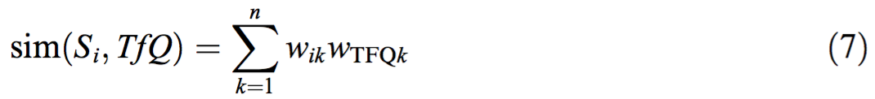
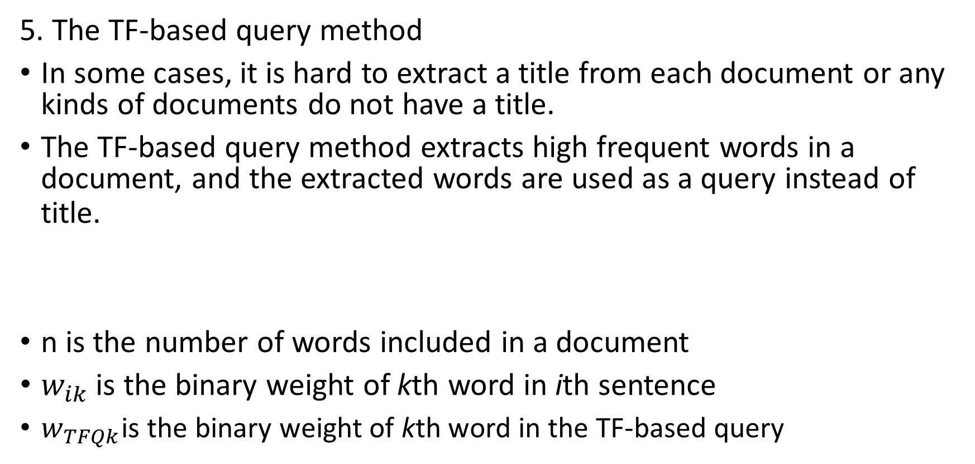
General Statistical Methods (5/5)
5. The TF-based query method
In some cases, it is hard to extract a title from each document or any kinds of documents do not have a title.
The TF-based query method extracts high frequent words in a document, and the extracted words are used as a query instead of title.
n is the number of words included in a document
$w_{ik}$ is the binary weight of kth word in ith sentence
$w_{TFQk}$is the binary weight of kth word in the TF-based query

Slide 12
The Proposed Method

Slide 13
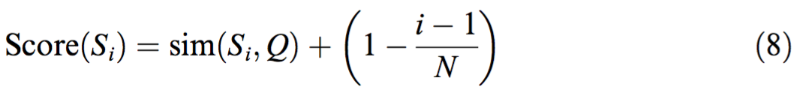
Stage1 - Extracting bi-gram pseudo sentences
First of all, the proposed method generates bi-gram pseudo sentences to solve the feature sparseness problem.
They are simply made by combining two adjacent sentences by sliding window. (The interval is one sentence.)
The proposed hybrid method linearly combines these methods as follows:
It combines Title and Location methods due to their experiment performance.
About 50% of them are selected as important bi-gram pseudo sentences.

Slide 14
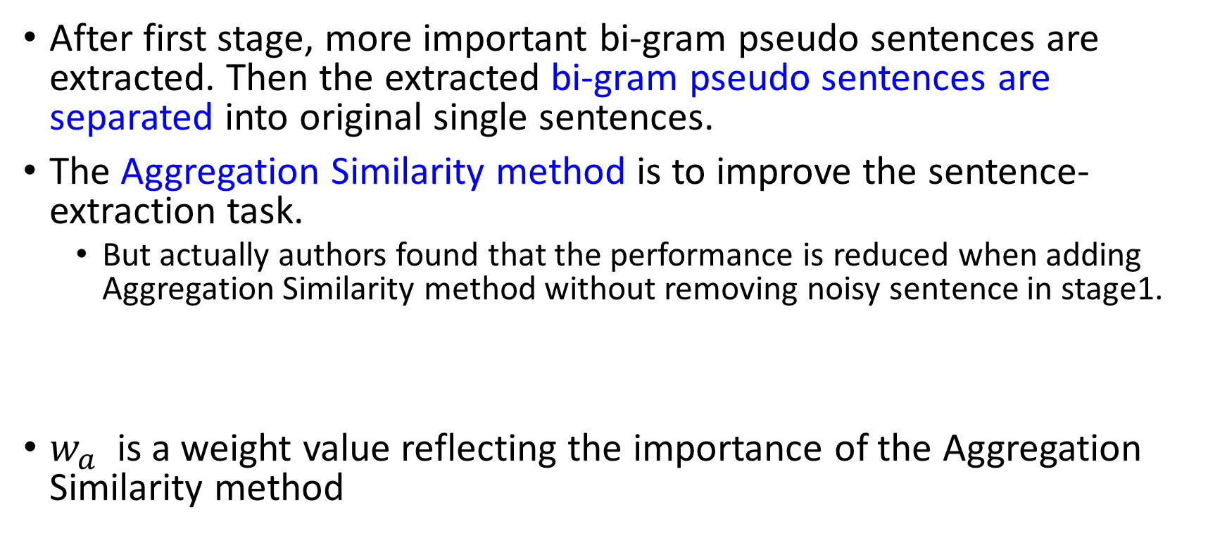
Stage2 - Generating summary (1/2)
After first stage, more important bi-gram pseudo sentences are extracted. Then the extracted bi-gram pseudo sentences are separated into original single sentences.
The Aggregation Similarity method is to improve the sentence-extraction task.
But actually authors found that the performance is reduced when adding Aggregation Similarity method without removing noisy sentence in stage1.
$w_{a}$ is a weight value reflecting the importance of the Aggregation Similarity method

Slide 15
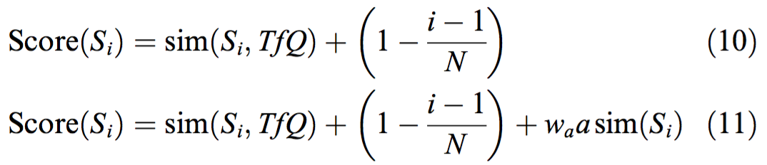
Stage2 - Generating summary (2/2)
If any document does not have title, the TF-based query method is used instead of the Title method :
Notes:
如果沒有標題就用TF-query來取代

Slide 16
Applying the proposed method to multi-document summarization (1/3)
There are two sentence-extraction processes for applying the method to multi-document summarization:
First: makes the summary of each document in a document cluster
Second: generates the final summary of the document cluster from the summaries created in the First

Slide 17
Applying the proposed method to multi-document summarization (2/3)
There are two different point from the method for single-document.
Title feature of cluster doesn’t exist
Location feature at the second task is useless (because all inputs are summaries)
Solutions:
the TF-based query method is used instead of title method
the location feature from the original document is used instead of that from a merged summary

Slide 18
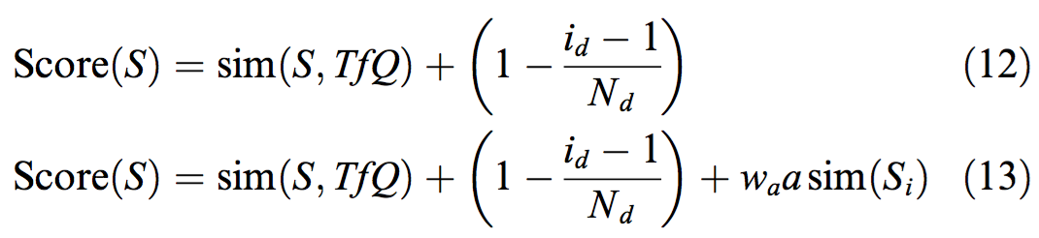
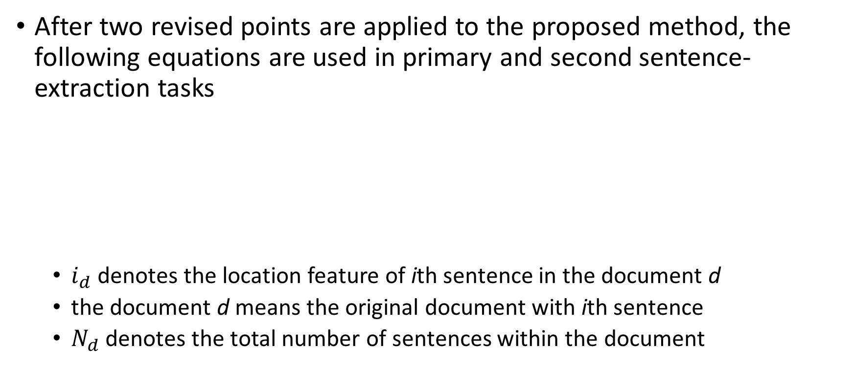
Applying the proposed method to multi-document summarization (3/3)
After two revised points are applied to the proposed method, the following equations are used in primary and second sentence-extraction tasks
$i_{d}$ denotes the location feature of ith sentence in the document d
the document d means the original document with ith sentence
$N_{d}$ denotes the total number of sentences within the document
Notes:
12的前項是TF query-based title算法，後項是目前的第S句是在原文章的第幾句（location method）

Slide 19
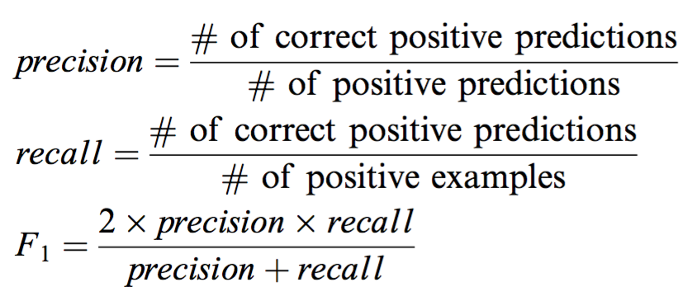
Experiment
Generate 30% and 10% summaries of documents
Using the 30% and 10% hand-made summaries as answer
Calculate precision, recall, and F1 measures.

Slide 20
GRAPHSUM: Discovering correlations among multiple terms for graph-based summarization
Elena Baralis (a), Luca Cagliero (a,b), Naeem Mahoto (a), Alessandro Fiori (b)
a. Department of Automatics and Information, Polytechnic University of Turin (Italy)
b. Institute for Cancer Research at Candiolo (IRCC) (Italy)
Information Sciences, 2012

Slide 21
Introduction (1/5)
Summarizers may be classified as:
sentence-based: if they partition the documents into sentences and select the most informative ones
keyword-based: if they detect salient document keywords.
In sentence-based summarization, several research efforts have been devoted to adopting data mining techniques, probabilistic or co-occurrence-based strategies, or graph-based algorithms.
Graph-based summarization focuses on building a graph
nodes represent either single terms or document sentences
edges weigh the strength of the relationship between a pair of nodes

Slide 22
Introduction (2/5)
Based on the assumption that the nodes that are connected to many other nodes are more likely to carry salient information, the sentence selection process is driven by a graph index.
graph index produced by an established ranking algorithm (e.g., PageRank or HITS)
However, graph-based summarizers sometimes do not achieve high performance because of the intrinsic limitations:
Some methods do not consider the underlying correlations among multiple terms, some relevant facets of the analyzed data could be disregarded.
Some of the considered term correlations are potentially misleading, because they represent negatively correlated associations among terms.

Slide 23
Introduction (3/5)
This paper presents GRAPHSUM (Graph-based Summarizer), a new multi-document summarizer that relies on a graph-based summarization strategy.
The proposed approach entails building and evaluating a correlation graph
the graph nodes represent sets of document terms of arbitrary size.
the edges have a weight that indicates the strength of the correlation between the corresponding pair of nodes.
two nodes are connected by a bidirectional edge if their corresponding terms co-occur frequently.

Slide 24
Introduction (4/5)
The correlations among multiple terms are extracted using association rule mining (using Apriori).
The selection of the most representative sentences is driven by the correlation graph. To this purpose, GraphSum adopts a variant of the popular PageRank ranking algorithm, which also discriminates between positive and negative term set correlations.
GRAPHSUM does not rely on semantics-based models, it exploits only two basic language-dependent steps.
i.e., lemmatization and stopword elimination
More flexibility for different application context

Slide 25
Introduction (5/5)
Contribution:
using association rules to represent correlations among multiple terms
analyzing positive and negative term correlations separately for document summarization
performing no semantics-based analysis and a minimal number of language-dependent steps to preserve the flexibility

Slide 26
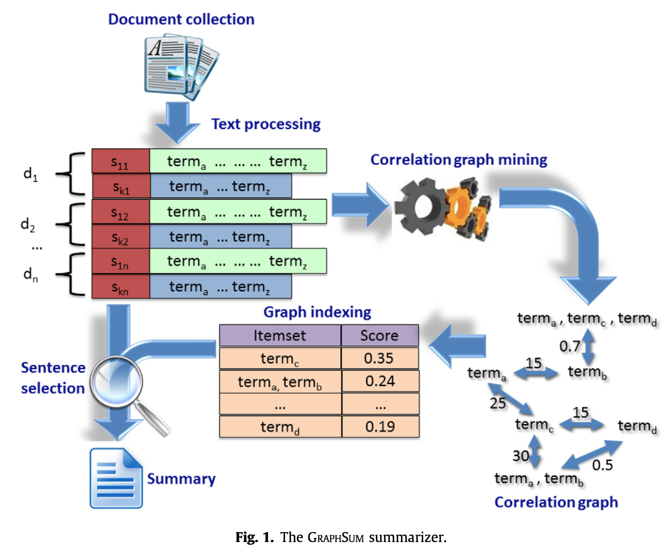
GraphSum - architecture
Main Steps:
Text Processing
Correlation graph mining
Graph indexing
Sentence selection
1
2
3
4

Slide 27
Background – Association Rule
If you are in a market, there are many bought items in your basket. This purchase of basket means Transactions.
If you purchase many times, a list that record all your purchases is Transaction Set. Transaction Set is a set of transactions.
If there are some items frequently occur in your transactions, and they satisfy certain threshold. They are called Frequent Itemsets.
E.g., If 偉志’ breakfast 10次有7次是{飯糰, 豆漿}，then {飯糰}, {豆漿}, {飯糰, 豆漿} all called frequent itemsets.
If two frequent itemset A and B are disjoint (no common item), and B often occur when A occurred, it Association Rule. ({A}->{B})
E.g., if buying 飯糰, often buying 豆漿 as well. ({飯糰}->{豆漿} )

Slide 28
Step 1. Text Processing

Slide 29
Text processing (1/3)
To preserve the portability and usability of the proposed system in different application contexts, it performs only two basic preprocessing.
Stopword Elimination: filter out the words that usually have little lexical content
E.g., words like The and To are eliminated
Lemmatization: reduce the document words to their corresponding lemma
E.g., word Analyzes is reduced to its corresponding lemma Analyze
After the preprocessing steps, the document collection can be modeled as a transactional dataset, where each transaction is a set of items.

Slide 30
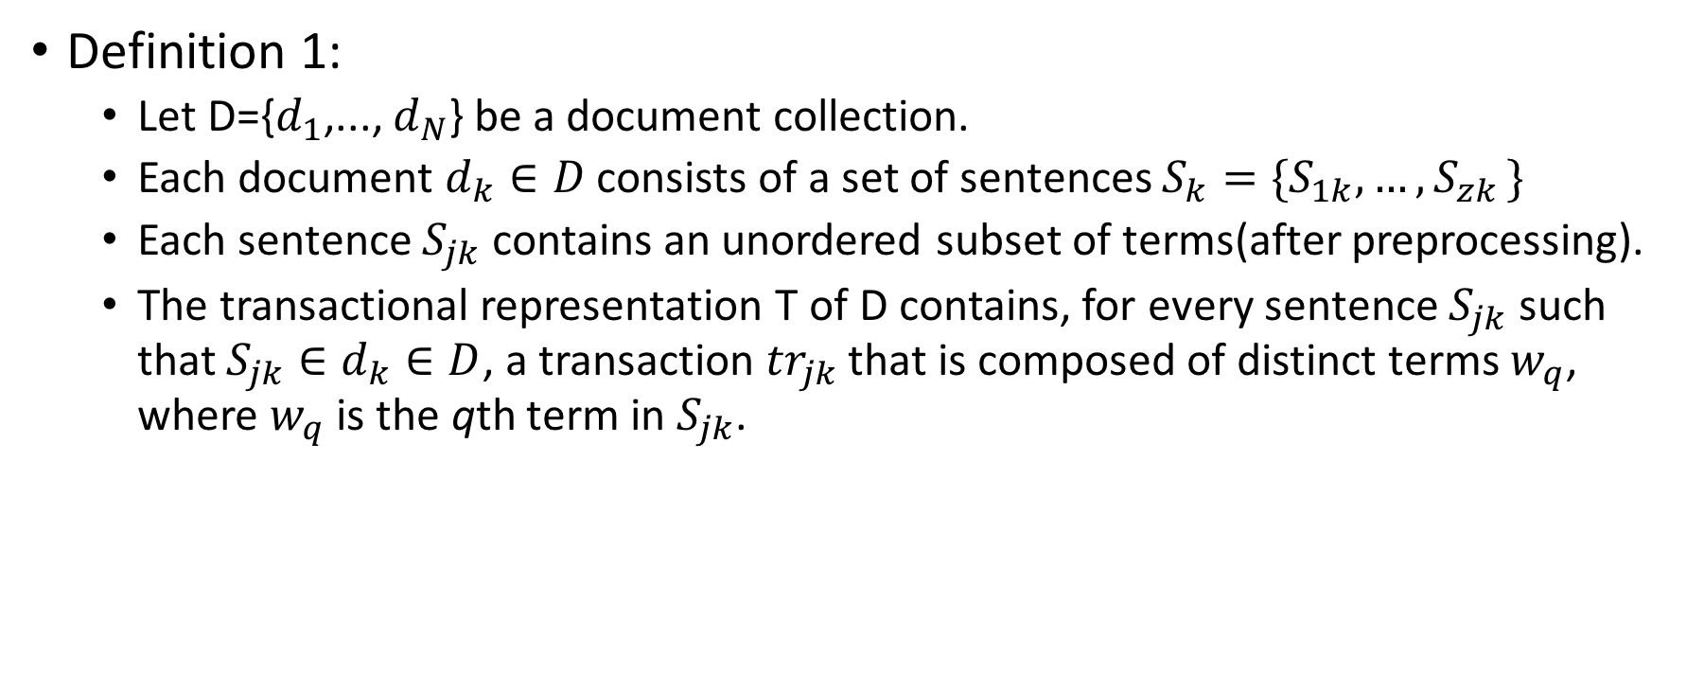
Text processing (2/3)
Definition 1:
Let D={$d_{1}$,..., $d_{N}$} be a document collection.
Each document $d_{k}∈D$ consists of a set of sentences $S_{k}=\{S_{1k},{…,S}_{zk}\}$
Each sentence $S_{jk}$ contains an unordered subset of terms(after preprocessing).
The transactional representation T of D contains, for every sentence $S_{jk}$ such that $S_{jk}∈d_{k}∈D$, a transaction ${tr}_{jk}$ that is composed of distinct terms $w_{q}$, where $w_{q}$ is the qth term in $S_{jk}$.

Slide 31
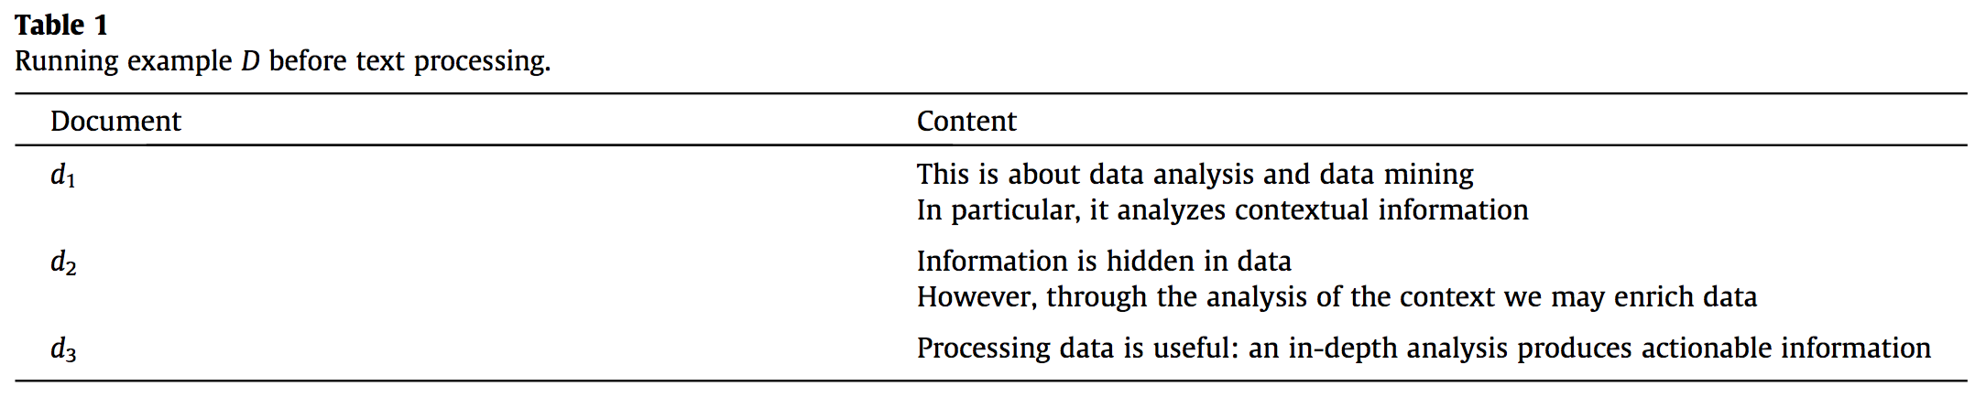
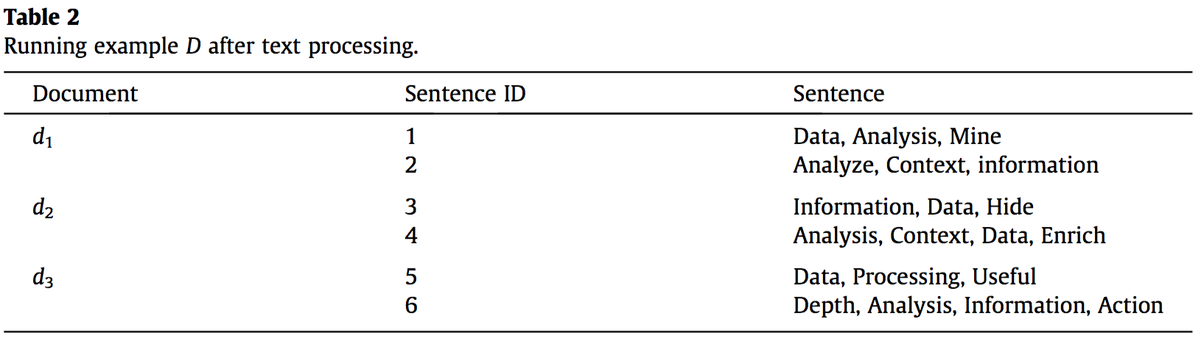
Text processing (3/3)

Slide 32
Step 2. Correlation graph mining

Slide 33
Correlation graph mining
The correlation graph mining task entails the following steps:
Frequent itemset mining
term set correlation estimate
graph generation
GraphSum using traditional Apriori rule mining algorithm here.

Slide 34
Frequent itemset mining
Discovering itemset that is equal to or higher than a given minimum support threshold minsup is said to be frequent
Support is that the ratio between the number of transactions in T that are covered by itemset I and the total number of transactions in T.

Slide 35
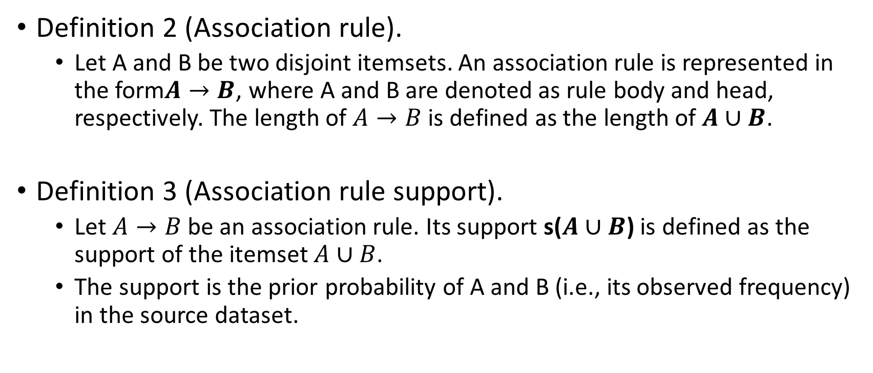
Term set correlation estimate (1/3)
Definition 2 (Association rule).
Let A and B be two disjoint itemsets. An association rule is represented in the form$A→B$, where A and B are denoted as rule body and head, respectively. The length of $A→B$is defined as the length of $A∪B$.
Definition 3 (Association rule support).
Let $A→B$be an association rule. Its support s($A∪B$) is defined as the support of the itemset $A∪B$.
The support is the prior probability of A and B (i.e., its observed frequency) in the source dataset.

Slide 36
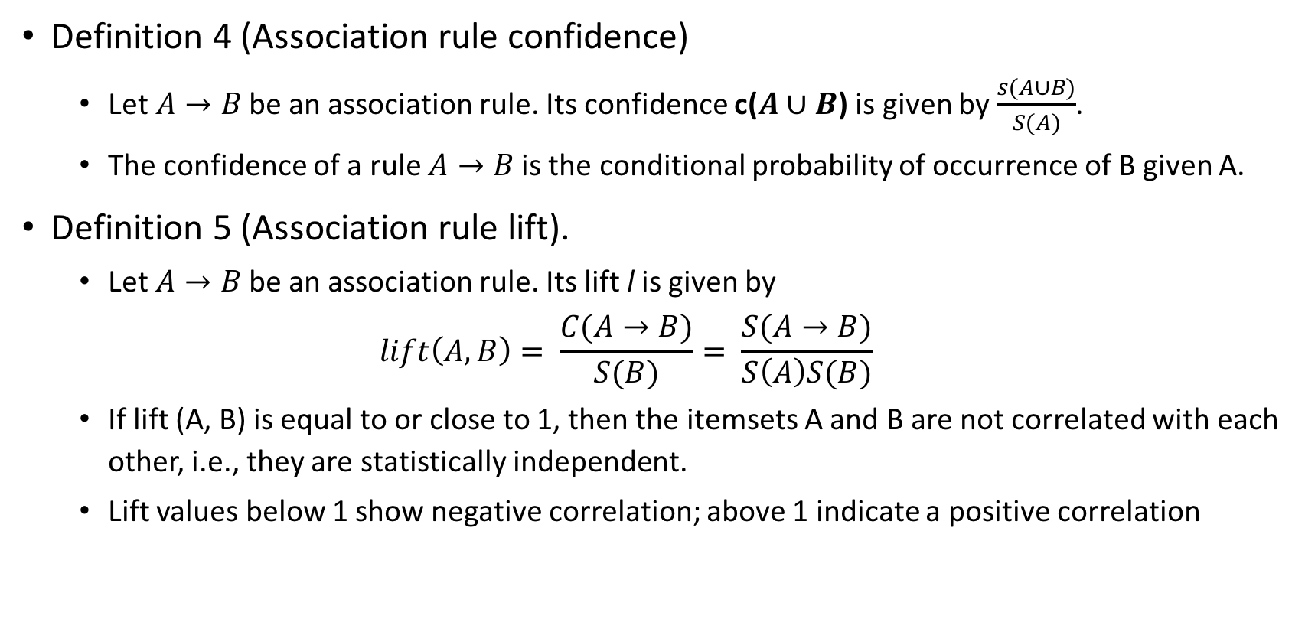
Term set correlation estimate (2/3)
Definition 4 (Association rule confidence)
Let $A→B$be an association rule. Its confidence c($A∪B$) is given by $\frac{s(A∪B)}{S(A)}$.
The confidence of a rule $A→B$is the conditional probability of occurrence of B given A.
Definition 5 (Association rule lift).
Let $A→B$be an association rule. Its lift l is given by
$$lift\left(A,B\right)= \frac{C(A→B)}{S(B)}= \frac{S(A→B)}{S\left(A\right)S(B)}$$
If lift (A, B) is equal to or close to 1, then the itemsets A and B are not correlated with each other, i.e., they are statistically independent.
Lift values below 1 show negative correlation; above 1 indicate a positive correlation

Slide 37
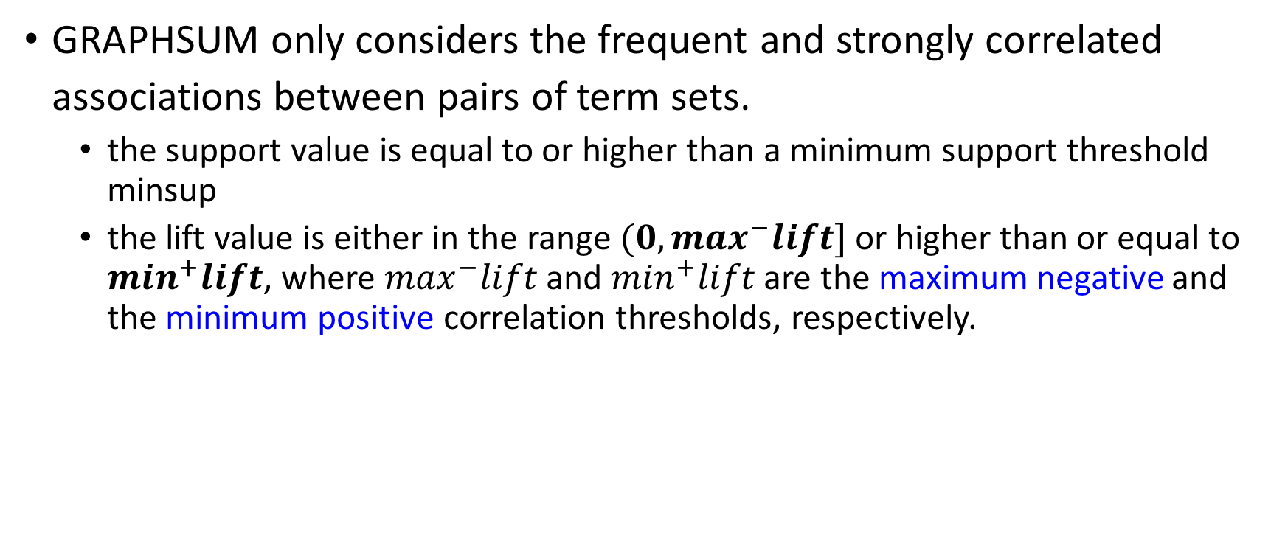
Term set correlation estimate (3/3)
GRAPHSUM only considers the frequent and strongly correlated associations between pairs of term sets.
the support value is equal to or higher than a minimum support threshold minsup
the lift value is either in the range $(0, \max^{−}lift]$ or higher than or equal to $\min^{+}lift$, where $\max^{−}lift$ and $\min^{+}lift$ are the maximum negative and the minimum positive correlation thresholds, respectively.

Slide 38
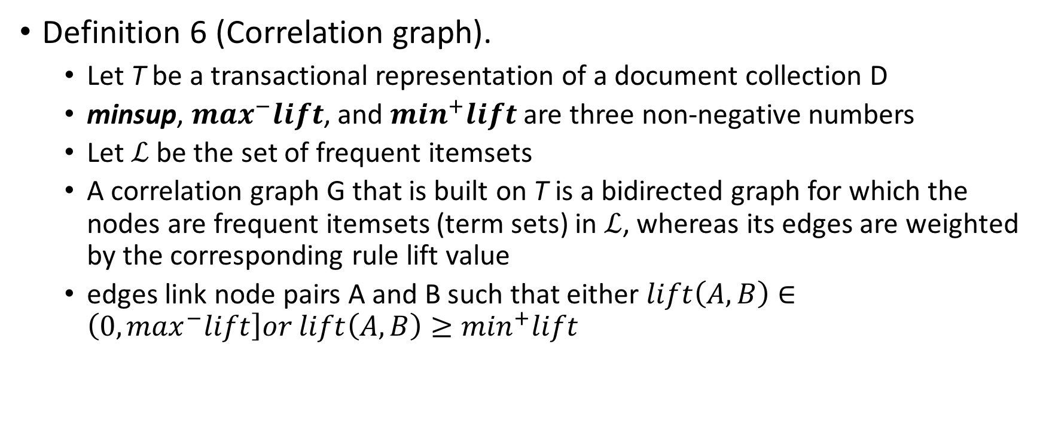
Correlation graph generation (1/2)
Definition 6 (Correlation graph).
Let T be a transactional representation of a document collection D
minsup, $\max^{−}lift$, and $\min^{+}lift$ are three non-negative numbers
Let $ℒ$ be the set of frequent itemsets
A correlation graph G that is built on T is a bidirected graph for which the nodes are frequent itemsets (term sets) in $ℒ$, whereas its edges are weighted by the corresponding rule lift value
edges link node pairs A and B such that either $lift\left(A,B\right)∈\left(0, \max^{−}lift\right]or lift\left(A,B\right)≥\min^{+}lift$

Slide 39
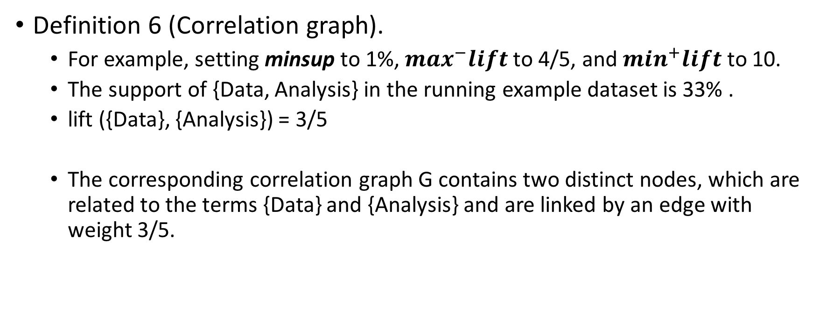
Correlation graph generation (2/2)
Definition 6 (Correlation graph).
For example, setting minsup to 1%, $\max^{−}lift$to 4/5, and $\min^{+}lift$ to 10.
The support of {Data, Analysis} in the running example dataset is 33% .
lift ({Data}, {Analysis}) = 3/5
The corresponding correlation graph G contains two distinct nodes, which are related to the terms {Data} and {Analysis} and are linked by an edge with weight 3/5.

Slide 40
Step 3. Graph Indexing

Slide 41
Graph indexing (1/3)
To measure the relevance of the graph nodes that were extracted from the source collection, GRAPHSUM adopts a variant of the traditional PageRank graph ranking algorithm.
Using the variant to differentiate between negative and positive term set correlations in order to assign a lower PageRank score to the nodes that are negatively correlated to one another.
PageRank: PageRank works by counting the number and quality of links to a page to determine of how important the website is.
The underlying assumption is that more important websites are likely to receive more links from other websites. (Page, 1998)

Slide 42
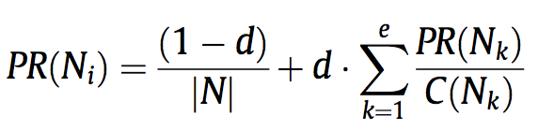
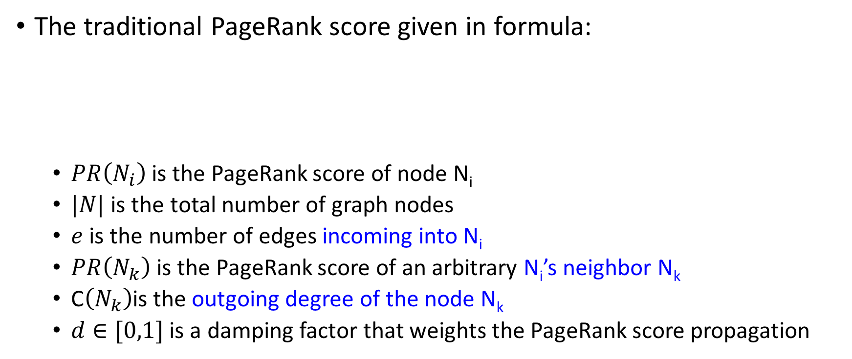
Graph indexing (2/3)
The traditional PageRank score given in formula:
$PR\left(N_{i}\right)$ is the PageRank score of node N_{i}
$|N|$ is the total number of graph nodes
$e$ is the number of edges incoming into N_{i}
$PR\left(N_{k}\right)$ is the PageRank score of an arbitrary N_{i}’s neighbor N_{k}
C$\left(N_{k}\right)$is the outgoing degree of the node N_{k}
$d∈[0,1]$ is a damping factor that weights the PageRank score propagation

Slide 43
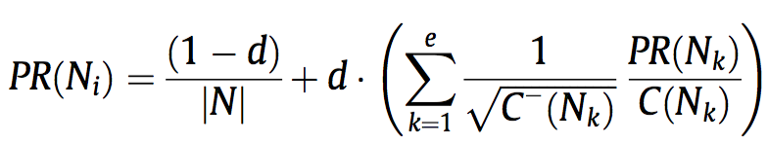
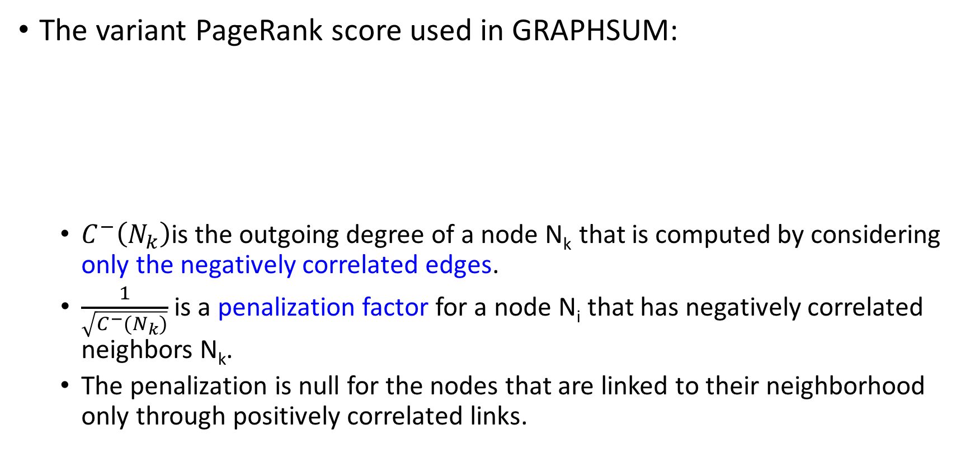
Graph indexing (3/3)
The variant PageRank score used in GRAPHSUM:
$C^{−}\left(N_{k}\right)$is the outgoing degree of a node N_{k} that is computed by considering only the negatively correlated edges.
$\frac{1}{\sqrt{C^{−}(N_{k})}}$ is a penalization factor for a node N_{i} that has negatively correlated neighbors N_{k}.
The penalization is null for the nodes that are linked to their neighborhood only through positively correlated links.

Slide 44
Step 4. Sentence Selection

Slide 45
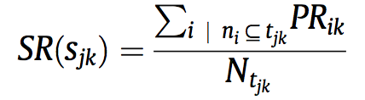
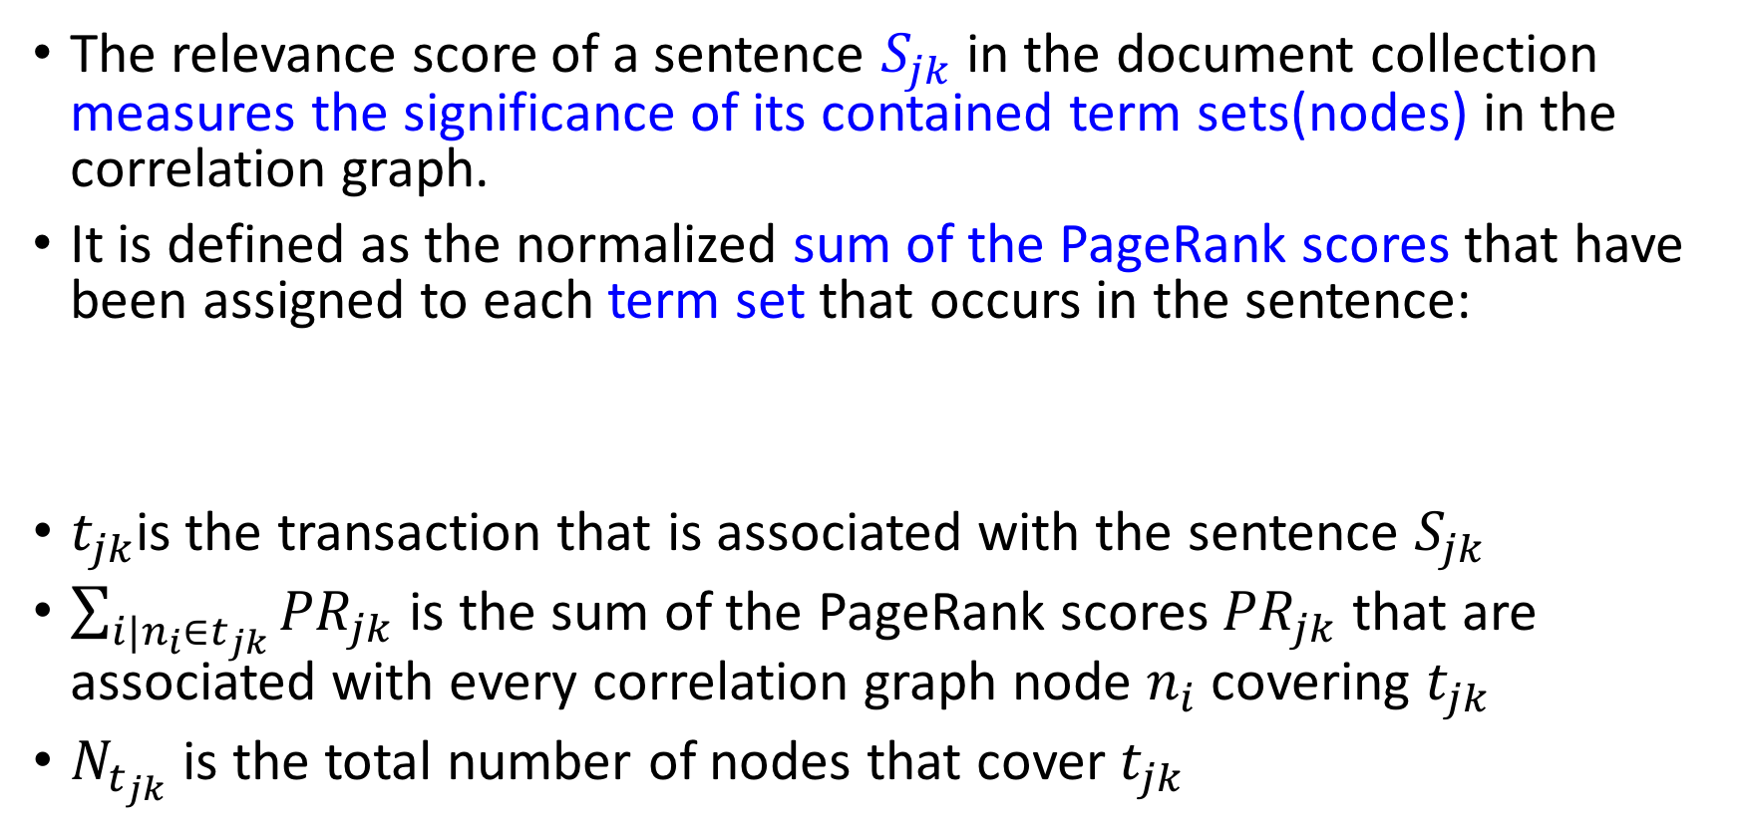
Sentence Relevance Score
The relevance score of a sentence $S_{jk}$ in the document collection measures the significance of its contained term sets(nodes) in the correlation graph.
It is defined as the normalized sum of the PageRank scores that have been assigned to each term set that occurs in the sentence:
$t_{jk}$is the transaction that is associated with the sentence $S_{jk}$
$\sum_{i|n_{i}∈t_{jk}}{{PR}_{jk}}$ is the sum of the PageRank scores ${PR}_{jk}$ that are associated with every correlation graph node $n_{i}$ covering $t_{jk}$
$N_{t_{jk}}$ is the total number of nodes that cover $t_{jk}$

Slide 46
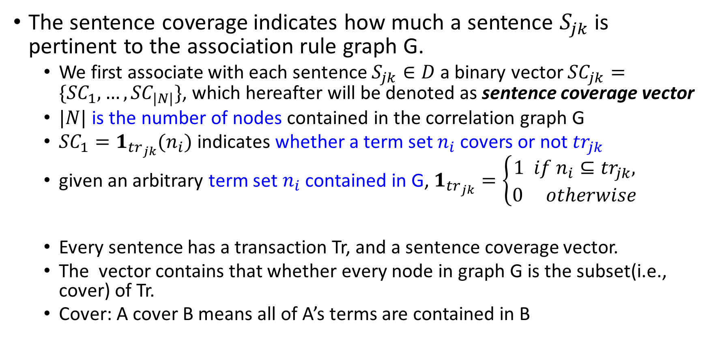
Sentence coverage
The sentence coverage indicates how much a sentence $S_{jk}$ is pertinent to the association rule graph G.
We first associate with each sentence $S_{jk}∈D$ a binary vector ${SC}_{jk}=\{{SC}_{1},…,{SC}_{|N|}\}$, which hereafter will be denoted as sentence coverage vector
$|N|$ is the number of nodes contained in the correlation graph G
${SC}_{1}=1_{{tr}_{jk}}(n_{i})$ indicates whether a term set $n_{i}$ covers or not ${tr}_{jk}$
given an arbitrary term set $n_{i}$ contained in G, $1_{{tr}_{jk}}=\left\{\begin{aligned}1 if n_{i}⊆{tr}_{jk}, \\ 0 otherwise\end{aligned}\right.$
Every sentence has a transaction Tr, and a sentence coverage vector.
The vector contains that whether every node in graph G is the subset(i.e., cover) of Tr.
Cover: A cover B means all of A’s terms are contained in B
Notes:
每個句子Sjk都有個transaction TRjk
每個句子會有一個sentence coverage vector（向量） 裡面存在著graph G裡面的每個node的term set是否是TRjk的子集，都是0/1的方式代表
1代表這句話的文字在某個node的term set中出現了, 所以如果一個句子的coverage vector很多1，代表這句話裡面所用到的字很重要，且跟其他重要的字很相關

Slide 47
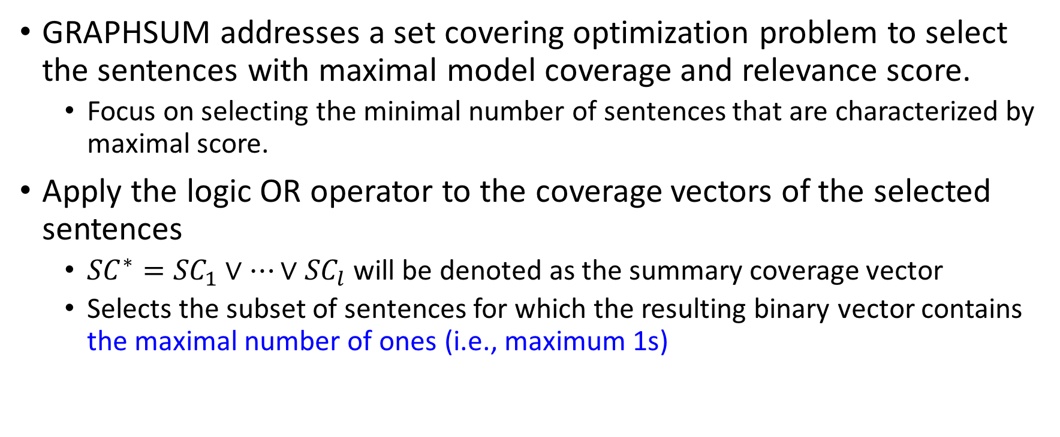
Solving set covering problem using greedy strategy
GRAPHSUM addresses a set covering optimization problem to select the sentences with maximal model coverage and relevance score.
Focus on selecting the minimal number of sentences that are characterized by maximal score.
Apply the logic OR operator to the coverage vectors of the selected sentences
${SC}^{∗}={SC}_{1}∨…∨{SC}_{l}$ will be denoted as the summary coverage vector
Selects the subset of sentences for which the resulting binary vector contains the maximal number of ones (i.e., maximum 1s)
Notes:
這邊我把原式的符號改成$∨$ 不然原本好像寫成and符號
用一個SC*的vector來獲得那些很重要的句子的聯集，很重要的句子代表coverage vector裡有很多1

Slide 48
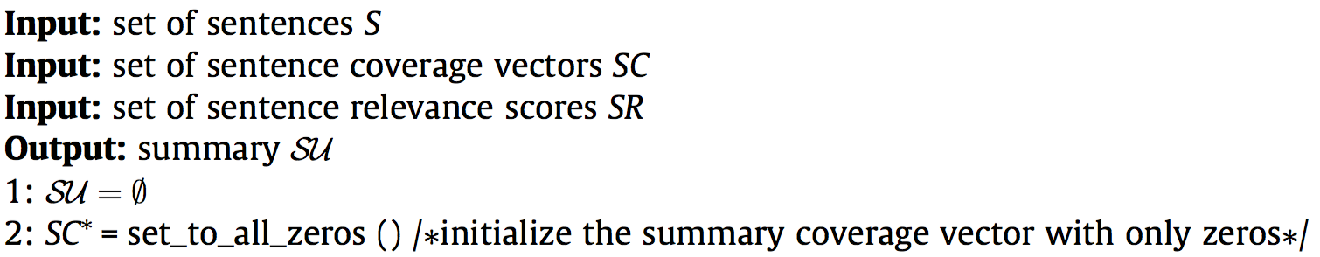
Greedy Sentence Selection (1/3)
Purpose: Find the most importance sentences
Do initialization

Slide 49
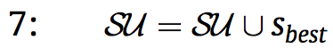
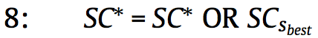
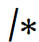
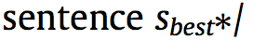
Greedy Sentence Selection (2/3)
Do iteration until SC* contains only 1s (all frequent itemsets are covered)
Get sentence that have maxOnes and add to Summary SU
Update the summary coverage vector SC*

Slide 50
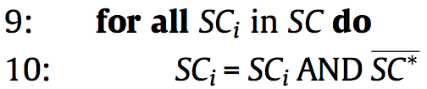
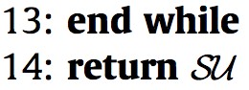
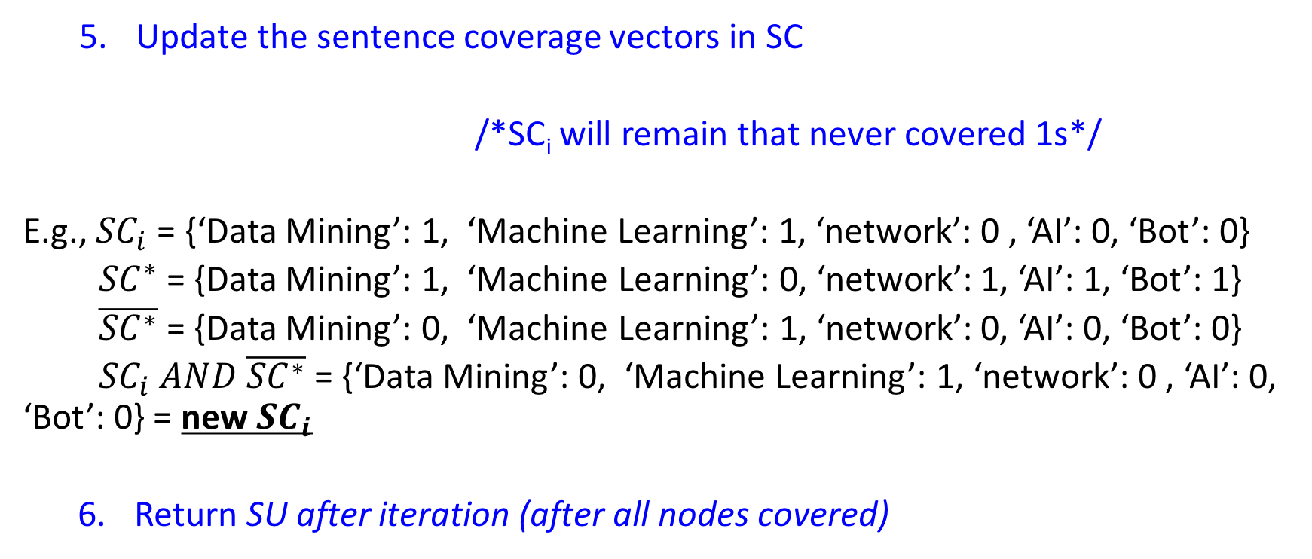
Greedy Sentence Selection (3/3)
Update the sentence coverage vectors in SC
/*SC_{i} will remain that never covered 1s*/
E.g., ${SC}_{i}$ = {‘Data Mining’: 1, ‘Machine Learning’: 1, ‘network’: 0 , ‘AI’: 0, ‘Bot’: 0}
${SC}^{∗}$ = {Data Mining’: 1, ‘Machine Learning’: 0, ‘network’: 1, ‘AI’: 1, ‘Bot’: 1}
$\overline{{SC}^{∗}}$ = {Data Mining’: 0, ‘Machine Learning’: 1, ‘network’: 0, ‘AI’: 0, ‘Bot’: 0}
${SC}_{i} AND \overline{{SC}^{∗}}$ = {‘Data Mining’: 0, ‘Machine Learning’: 1, ‘network’: 0 , ‘AI’: 0, ‘Bot’: 0} = new ${SC}_{i}$
Return SU after iteration (after all nodes covered)
Notes:
把每個SC和summary vector的反向量做AND運算
Summary vector裡面記著現在有哪些node已經被納入，哪些還沒，反向量會變成只有還沒的node vector變成1
所以AND完後，SCi會剩下每個SC裡面還沒被納入SC*的向量們
目的是後面只想要知道新的term set而已

